Slide 1
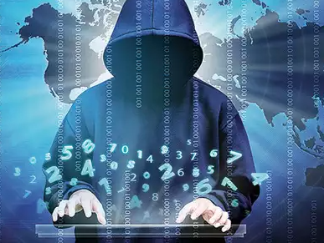
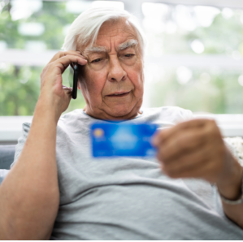

Fight against cyber crime
Audience: Senior citizen
INFO 5600: Information Access and
Knowledge Inquiry
Topic: Internet Crime Complaint Center (IC3)
Team members (Group 1):
Sadia Mahbub (10971223)
Meela Uday Kumar (11513047)
Omika Mishra (11442654)

Slide 2


Purpose of the project Brief Description Literature Review Introduction to Internet Crime Complaint Center Methods used by perpetrators to Deceive and Defraud Elderly Victims How to identifying cybercrime Homepage of IC3 File Elder Fraud Complaint How to use IC3 File Elder Fraud Complaint Elder justice initiative The Department's Elder Justice Activities Learning Outcome Evaluation Reference

Slide 3



Purpose of the project
The goal of this project is to educate
senior citizens about how use Internet Crime Complaint Center (IC3) website to register a complaint against cyber crime, get aware of various initiative and activities provided to help them by IC3 to fight against cyber crime and understand how to identify them.
Senior Citizens will be given a presentation
about IC3 and how to used for their benefit
Denton old age home

Slide 4

Brief Description
The world has been growing at incredible fast rate along with-it internet has boomed at an exponential rate. Internet is a boon and a curse too. There are so many people who have fall prey to cybercrime and the rate of these crimes are rising by each passing day. Many people including kids, youngsters and old people don’t understand how to use internet safely and fall prey to these crimes. Our main aim in this project is educate senior citizens living at Denton old age home about how to use Internet Crime Complaint Center (IC3) website to register a complaint against cyber crime and get aware of various initiative and activities provided to help them by IC3 to fight against cyber crime and understand how to identify them. After this presentation, our audience will be learned and aware about using cyber crime and using IC3 to look for information and file any cyber compliant.

Slide 5
Literature Review
Cyberspace is a space where a lot of cybercrimes can happen. There are a lot of cybercrime that happen against elderly like the medical fraud, insurance fraud, credit card frauds and many more. Arfi mentions that the reason for cybercrime are that computers are vulnerable as they are easy to access as it is easy to bypass the security system, another reason is that the operating system is complex, and it is difficult for human mind to understand the logic behind them, and hackers find small gaps and break into the system (Arfi & Agarwal,p3). With rise in cyber crime the law enforcement like Internet Crime Complaint Center is trying it’s best to protect the citizens of united states from it. The author mentions that, to determine the capacity law enforcements agencies to investigate digital crime is knowing the number of crime happening in cyberspace, the number of cases, and how many investigators. It was reported in 2009 by IC3 that it received a total of 336,665 complaints and the complains are in increasing per year. Internet is boon and a bane. We learn a lot from it but at the same time we can easily fall prey to cybercrime. According to IC3, cybercrimes are occurred often in in west states like California, Washington, and Nevada. Most commonly these crimes were done by people who have a history of past conviction, religious and gang affliction, and many more (Marcum, et all, p 5).

Slide 6
Organization like IC3 who are fighting hard with these crimes, they are doing activities and initiatives to spread awareness among the people. The “Internet Crime Complaint Center (IC3) is a reporting and referral system for internet crime complaints from people in the USA and around the world. Through an online complaint form and a team of agents and analysts, IC3 serves the public and the USA and international law enforcement agencies investigating internet crime” (Adam,2008, p3).
IC3 is managed by federal bureau of investigation and is used for complaining about online crimes. Thomas mentions that IC3 receives complains ranging from child pornography to advance fee fraud victimization and the most common are consumer victimization via auction sites (Thomas & et.all, 2012,p 4). People file complaints on the website of IC3 and a lot of website like ebay, paypal direct them IC3 for registering complaints regarding any cyber crime. They update their website often regarding any new types of crimes and people can go to website and learn about it. Thomas mentions that it was found that most victims are male, and 70 percent were 30 or older and the third-party payments services portal like ebay where people use credit or debit card to do an online payment for purchases are the website, they used to perform a payments and email is a common way to contact people to buy things and people fall prey to cyber crime. and these crimes were reported by IC3 website (Thomas & et.all, 2012, p9). However, IC3 is trying hard to upkeep and update its detective with training and are very quick in finding the pattern to cybercrime and responding to it hence it is great website to place a complaint regarding cybercrime by any individuals or business.

Slide 7
Introduction to Internet Crime Complaint Center
The Internet crime complaint center (IC3) was established in 2000 to receive reports of internet crime from public. Since its inception, more that 4 million complaints have been reported to IC3.
Goal of IC3 is provide secure and easy way to report any kind of cyber or internet related crime.
IC3, part of FBI’s cyber division receives about 800 complaints a day.
The kind of complaints IC3 receives are Property Right (IPR) matters, hacking, online extortion, identity and many more.

Slide 8
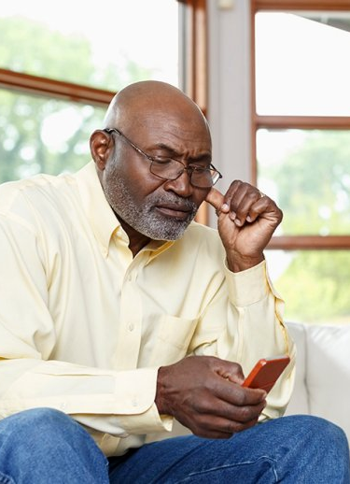
Methods used by perpetrators to Deceive and Defraud Elderly Victims
Authorities have identified few scams which were notably used against elderly citizens are as follows :
Romance scam
Tech support Scam
Grand parent scam
Lottery Scam
Home Repair scam
Tv/Radio Scam

Slide 9
How to identifying cybercrime
Do not click on link or advertisment immediatly
Examine the links for their actual source /Hoger over the links to know the redirect page before clicking it.
Examine the link for spelling/grammatical errors
Do not download any softwares from illegitimate sources
Always keep anti virus software in your machines updated and Turn them on
If any thing seems suspicious, do no hesitate to report that page or source
If you feel, your machine is under fraudster control, please seek support of concerned authority

Slide 10
Homepage of IC3
Once you land on the home page. One can see the simple and informative layout.
On the top there are “More” “File a complaint”, “Consumer alerts”, “Industry Alerts”, “BEC”, “Ransomware”, “Elder Fraud”, “Scams”.
In the frequently asked questions there is information regarding how common question.
On the left side of “frequently asked question” there is “news release” which has information regarding any latest development and top news article regarding cyber crime.
On the right side of “frequently asked question” there is “Annual Report” which has “Elder fraud report” and “Internet fraud report”
For this project we will clicking on “Elder Fraud” and explain it.

Slide 11
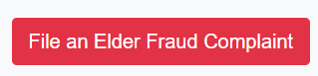
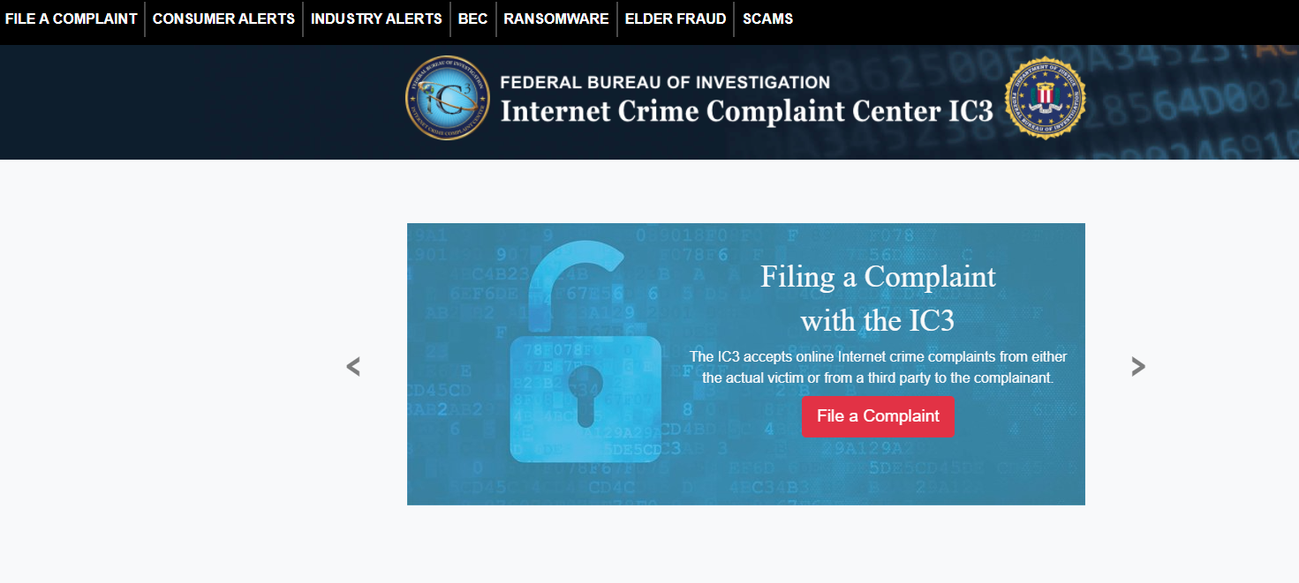
How to use IC3
Have a complaint about cyber crime? Welcome to IC3.
When you land on homepage, one can see “File a complaint”, “Consumer alerts”, “Industry Alerts”, “BEC”, “Ransomware”, “Elder Fraud”, “Scams”.
Lets venture to the tab of “Elder Fraud”. It contains all the information specific to our topic.
Any person of age 60 and over who is subjected to cyber crime is considered under “Elder fraud”.
To file a complaint one has to click on “File an Elder Fraud Complaint”

Slide 12
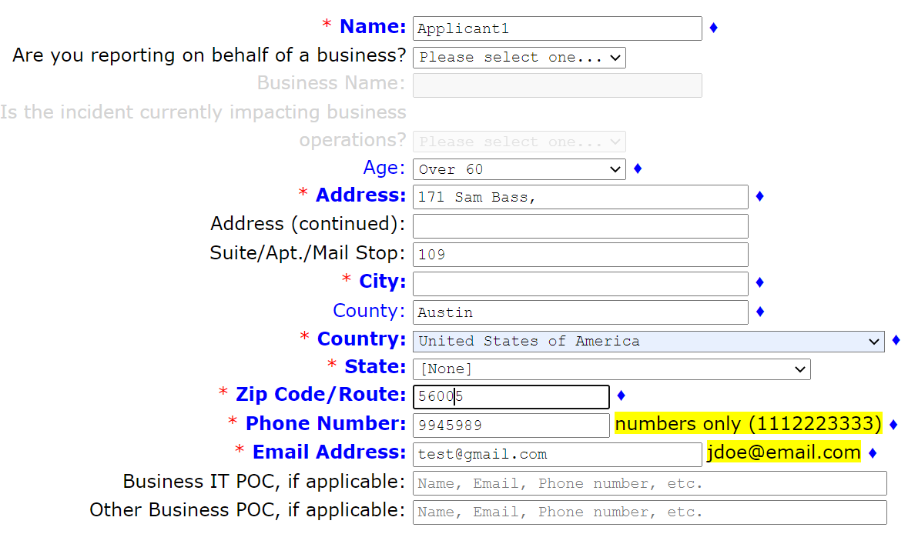
File Elder Fraud Complaint
After clicking one will land to a form looking like this.
Applicant has to fill in information like Name, Age, Address, City, County, Country, State, Zip, Phone number, email address.
We have placed a dummy values for example.
It is best to fill in the details as accurately as possible so IC3 can help the applicant of complain.

Slide 13
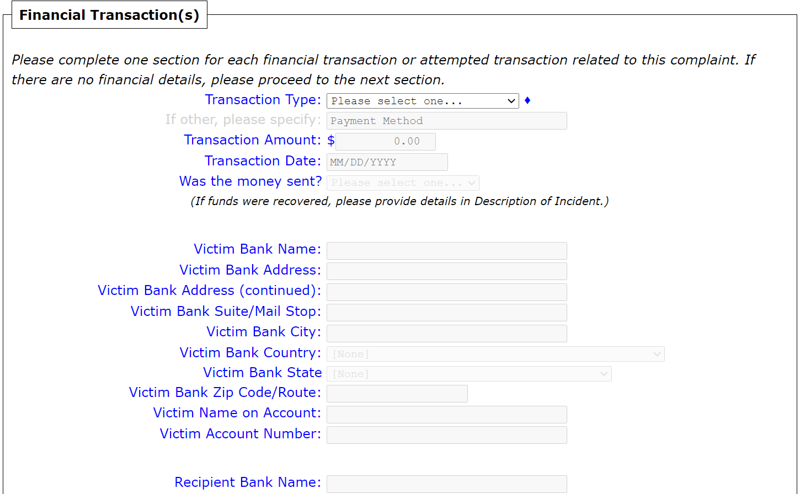
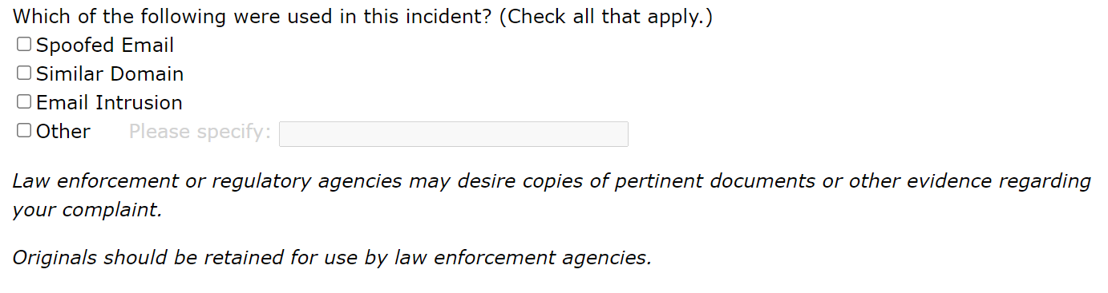
On further scrolling down there is a section of Financial Transactions.
Here the applicant will fill out details of any bank transaction happened when the crime tool place.
The applicant will fill out values like Transaction type, amount, Date, Victim Bank name, Victim address, country, state, account and few more details.
Next, there is section asking what were the ways the incident took place like spoofed email, domain.

Slide 14
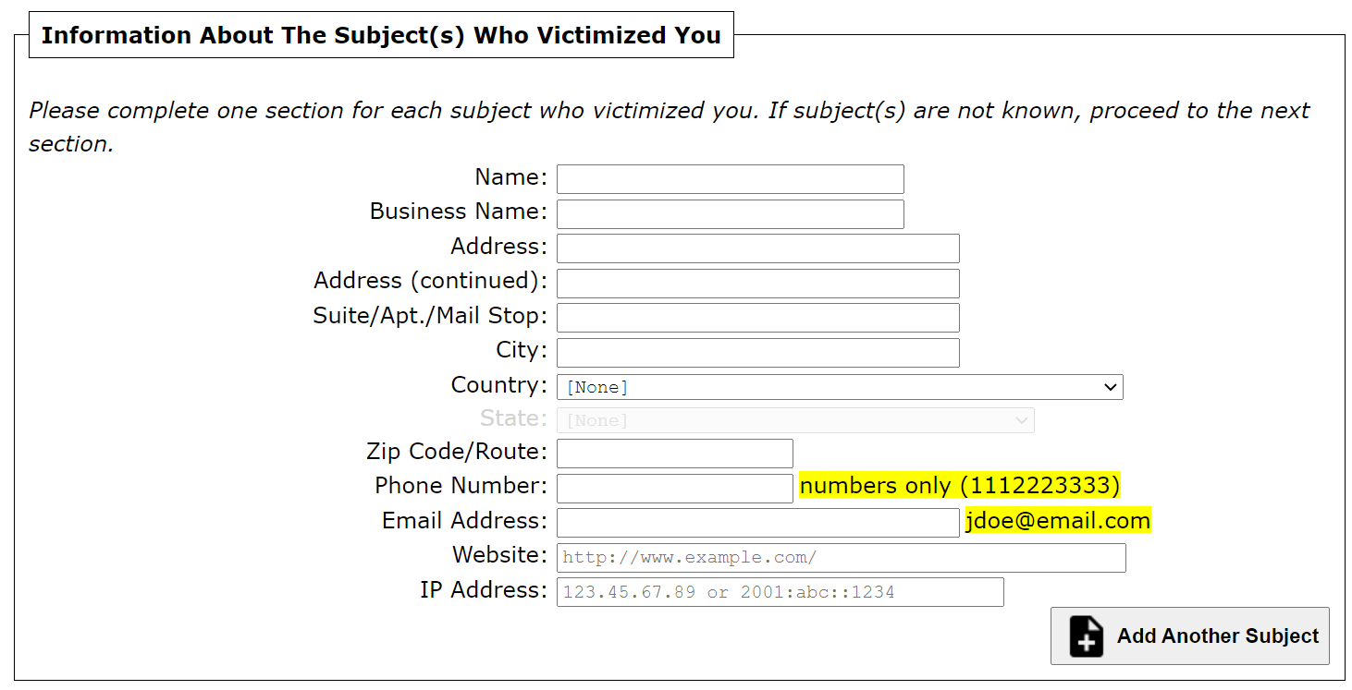
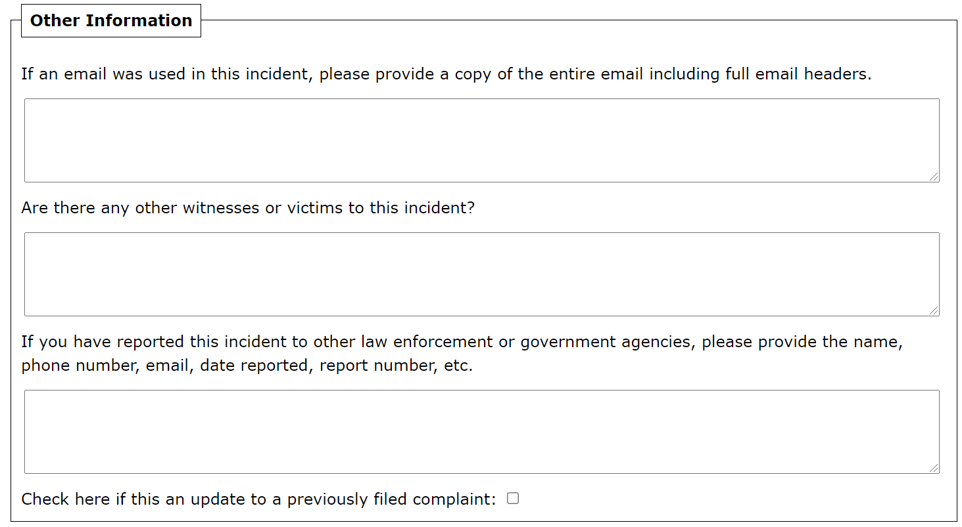
On further scrolling down there is a section of Information about the subjects who victimized you.
Here the applicant will fill out details like name, business name, address, city country, zip code, email address, website and IP address. Basically, fill out any information that the victims knows about the person who victimized them.
Further there is a section asking few more details like provide the copy of email, any other victim or witness to the crime.

Slide 15
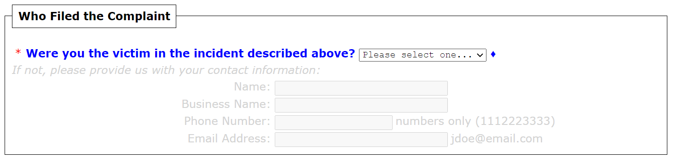
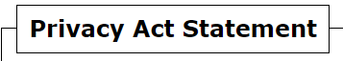
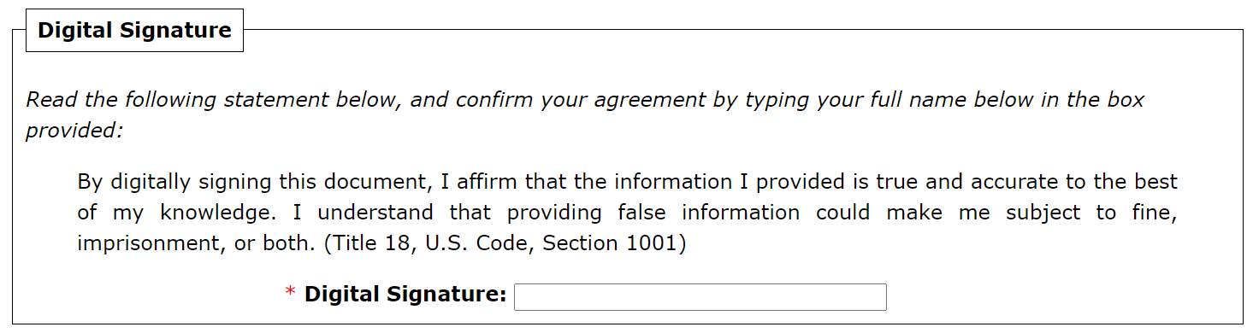
This is the final section on filling out the form named who filed the compliant.
Asking if applicant was the victim with some drop down options which yes or no.
And finally, the signature of the applicant.

Slide 16

Department of justice Elder justice initiative
After filing an Elder Fraud Complaint one can get some helpful information using the external links provided on the bottom left corner of the same page. One of those links is DOJ Elder Justice Initiative. The Department of Justice is committed to fighting for justice for older Americans through a robust and holistic response. On this page, one can learn about the activities of the Department's Elder Justice.

Slide 17
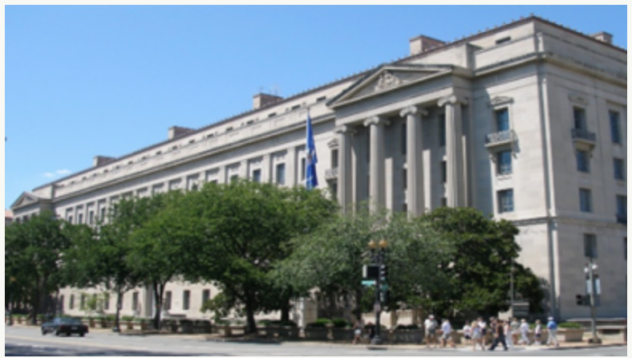
The Department's Elder Justice Activities
FEDERAL LAW ENFORCEMENT ACTIVITIES
The Department is pursuing a wide array of foreign and domestic schemes impacting older Americans. For example: pursuing nursing homes that are denying Medicare and Medicaid beneficiaries essential nursing services, transnational fraud schemes.

Slide 18
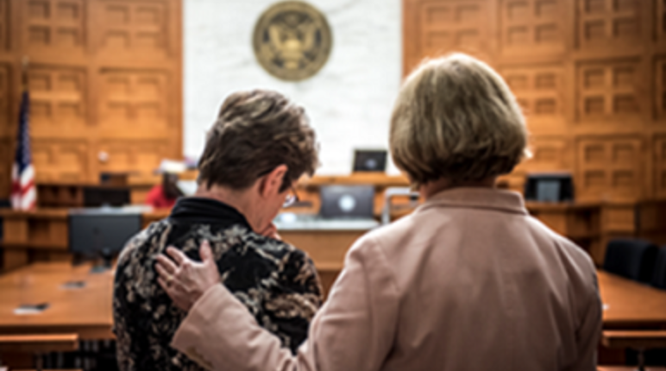
The Department's Elder Justice Activities
PROVIDING SUPPORT TO OLDER VICTIMS
The Department supports older victims and their families in reporting fraud and/or finding local assistance. For those searching for resources online, the Elder Justice Neighborhood Map is designed to easily locate state-specific resources. The Department is advancing prevention through its elder abuse prevention research.

Slide 19

The Department's Elder Justice Activities
ENHANCING STATE AND LOCAL ELDER JUSTICE EFFORTS
The Department supports the efforts of state and local law enforcement, and other elder justice professionals, through the development of training, resources, and tools. For example: support the development of the Elder Abuse Guide (EAGLE) for Law Enforcement, EAGLE online training, etc.

Slide 20

The Department's Elder Justice Activities
RAISING PUBLIC AWARENESS
To prevent elder abuse and financial fraud from occurring in the first place, the department actively promotes public awareness. Elder Justice Coordinators throughout the country regularly participate in public awareness events. The Elder Justice Website hosts a wide array of public awareness resources.

Slide 21
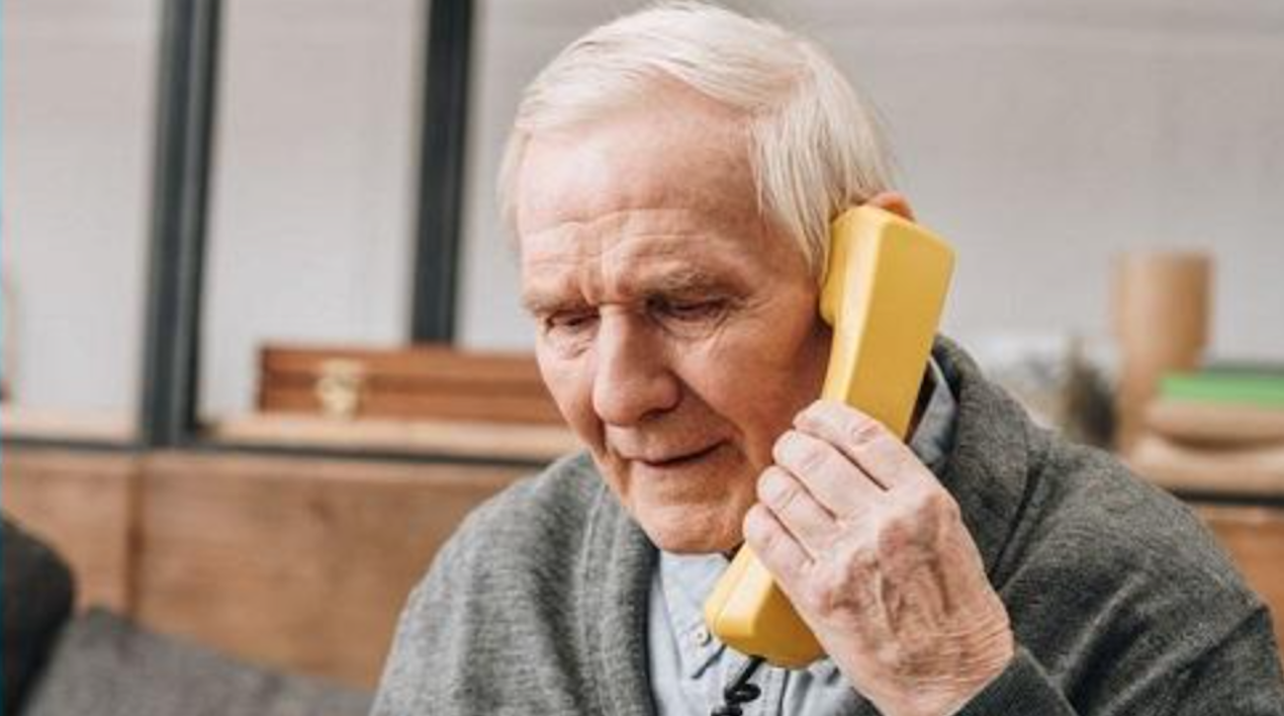
The Department's Elder Justice Activities
National Elder Fraud Hotline
The Department manages the National Elder Fraud Hotline, the first national hotline to assist older victims and their families in reporting fraud and/or finding local assistance:
833–FRAUD–11
or
833–372–8311
Monday-Friday (10:00am-06:00 pm, ET)

Slide 22
Learning Outcome
Apply: Audience will be aware about Internet Crime Complaint Center (IC3) website and will be able to APPLY the knowledge to register a complaint against cyber crime.
How: Audience will know HOW they can safeguard themselves.
Defend: Audience will know the initiatives and activities. They will understand about various activities by IC3 and they will be able to DEFEND themselves against cyber crime.
Support: Audience will know they are not alone and will understand that there are various law enforcement to help and SUPPORT them through development of training, resources and tools.
Discover : Audience will be able to DISCOVER when they someone trying to victimize them.
Conclude: With the help of the Instruction project a victim will be able to CONCLUDE the cyber crime complaint, if they fall prey to it.

Slide 23
Evaluation
After viewing the presentation to our audience at Denton old age home, a survey with basic questions to register their experience and feedback is provided to audience. This survey can be taken on internet by simply on the link below. This form was created using google forms.
The survey has 5 question that are combination of multiple-choice question, multiple selection and an open-ended question asking for any comments or concerns. By this form we are trying to understand how well our audience understood the instructional project and their understanding of how to use the website to register a complaint about cybercrime and initiative undertaken by IC3. By this we will be able to understand how useful was the presentation to our targeted audience.
Please click on the link below for the giving a feedback
https://docs.google.com/forms/d/e/1FAIpQLSdQ0CyPhocTx_Rz8lBv4rnXIS5-DJfTrkXi8tJ0CVD-RVi3Zw/viewform?usp=sf_link

Slide 24
Reference
Arfi, Nabat & Agarwal, Shalini,. (2013). Knowledge of Cybercrime among Elderly. 4. 2229-5518. https://www.researchgate.net/publication/242654499_Knowledge_of_Cybercrime_among_Elderly
Heinonen JA, Holt TJ, Wilson JM. Product Counterfeits in the Online Environment: An Empirical Assessment of Victimization and Reporting Characteristics. International Criminal Justice Review. 2012;22(4):353-371. doi:10.1177/1057567712465755. https://journals.sagepub.com/doi/full/10.1177/1057567712465755
Greg Gogolin,The Digital Crime Tsunami,Digital Investigation,Volume 7, Issues 1–2, 2010,Pages 3-8,ISSN 1742-2876,https://doi.org/10.1016/j.diin.2010.07.001. https://www.sciencedirect.com/science/article/pii/S1742287610000526
HOLT, T.; BOSSLER, A. An Assessment of the Current State of Cybercrime Scholarship. Deviant Behavior, [s. l.], v. 35, n. 1, p. 20–40, 2014. DOI 10.1080/01639625.2013.822209. Disponível em: https://search.ebscohost.com/login.aspx?direct=true&db=tsh&AN=90430380&scope=site. Acesso em: 24 nov. 2021.
Internet Crime Complaint Center (IC3) | Perpetrators Use Various Methods to Deceive and Defraud Elderly Victims For Financial Gain. https://www.ic3.gov/Media/Y2019/PSA190919
Internet Crime Complaint Center (IC3) | FBI Warns of a Grandparent Fraud Scheme Using Couriers. https://www.ic3.gov/Media/Y2021/PSA210729
Internet Crime Complaint Center(IC3) | Elder Fraud. https://www.ic3.gov/Home/EF

